Slide 1
CS 551
Spring 2025

Slide 2
Concurrency Part 2

Slide 4
We are going to bring in two namespaces, one for threads and one for convenience

Slide 5
We’ll make a single function that prints some stuff in two different threads

Slide 6
The first thing this function does is spawn() a new thread

Slide 7
Spawn takes a closure (anonymous function) just like map() did

Slide 8
Basically, whatever is in the closure gets run in the spawned thread

Slide 9
Here, we are just looping through 9 times (1..10) and printing

Slide 10
At the end of each loop we will sleep() – i.e., this thread will stop working and let another thread run

Slide 11
In the main thread, we will just loop 4 times, sleeping between loops

Slide 12
Note that I put this function in a file called spawn.rs

Slide 13
That means in main() we need to bring in our “spawn” module

Slide 14
Then we just call the function we made

Slide 15
Any ideas on what the output will be?

Slide 16
Let’s see it run…

Slide 17
What happened?
The print_two_threads() method creates a new thread and loops through 9 times, but we didn’t see 9 outputs!
What happened?!??!
The main thread only ran 4 times → main thread exited before spawned thread finished!

Slide 19
Now we are going to get a JoinHandle<T> for the thread we spawn

Slide 20
The parent thread can simply join() on this handle and it will wait until the other thread has finished

Slide 21
Let’s see it run

Slide 22
Join
Calling join() blocks the thread currently running until the thread represented by the handle terminates
Where we put the join affects things a lot!

Slide 23
Join
Calling join() blocks the thread currently running until the thread represented by the handle terminates
Where we put the join affects things a lot!

Slide 25
What will output be?

Slide 26
Let’s run it…

Slide 27
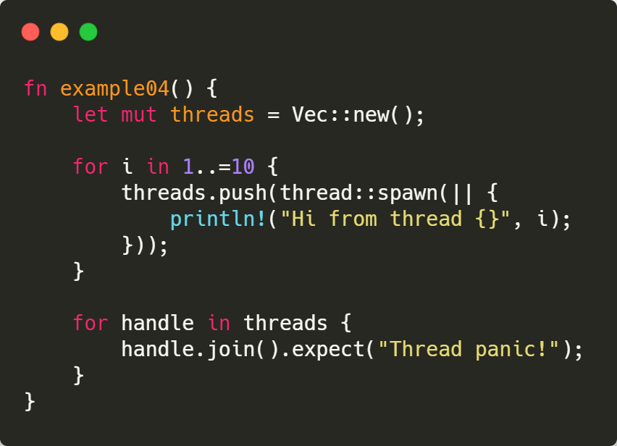

Slide 28
Will it compile?

Slide 29
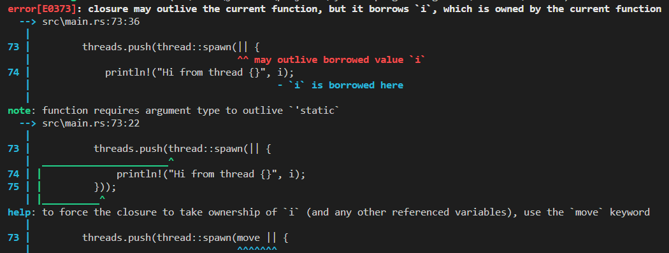

Slide 30
How can we move data between threads?
We know that a closure is running in a different thread…
What did we just learn about that might be useful to move data?
The move keyword!
Does this help us with concurrency issues at all?
Will we ever have to worry about another thread messing with our variables if we have moved them?

Slide 33
Will it compile?

Slide 34
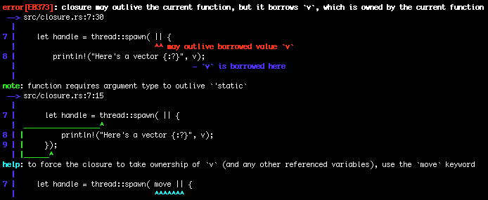
Will it compile?

Slide 37
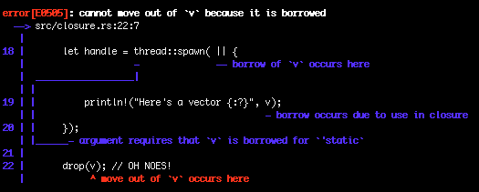

Slide 39
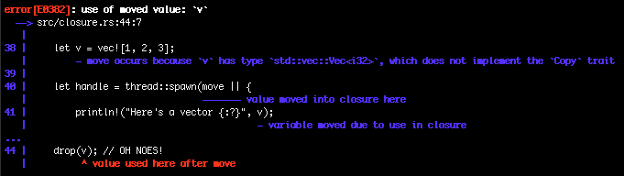

Slide 40
Concurrency models
There are several ways to do concurrency
The two most comment are shared memory and message passing
What is shared memory?
Threads share state by sharing the same memory!
What is message passing?
Share state by communicating
Passing messages between threads

Slide 41
Why choose one over the other?
What are benefits of shared memory?
Relatively lower resource overhead
Can be faster because you aren’t having to move data around
Can make certain classes of problems easier to deal with
What are the cons of shared memory?
Lots of opportunity for things to go wrong!
Difficult to distribute horizontally (multiple machines)
There are big time research projects building distributed shared memory systems
They are crazy!

Slide 42
Why choose one over the other?
What are the benefits of message passing?
It’s a much simpler model to deal with as a programmer
It is much, much easier to maintain safety
Because the fundamental idea is for threads to communicate with each other, the same basic abstraction can work in a distributed environment
What are the cons?
Relatively high overhead since data has to be moved around
Usually requires a higher level abstraction in terms of programming
Abstractions are generally ”expensive”

Slide 43
Message Passing
Message passing is a much simpler model and overall it scales quite well
Go was designed by google for highly concurrent/distributed applications
Go specifically avoids any memory sharing model
Message passing also has a lot of natural affinity to certain paradigms of programming
Actor model
Object oriented programming

Slide 44
Message Passing in Rust - Channels
Rust has some special constructs that allow us to achieve message passing based multithreading
The most straight forward of these is the channel
Not specific to Rust; many languages have channels now
A channel has two ends: transmitter and receiver
The transmitter sends data to the receiver
The receiver receives data from the transmitter
This is not dissimilar to producer and consumer model

Slide 46
mpsc::channel() returns a tuple

Slide 47
MPSC stands for multiple producer single consumer

Slide 48
mpsc::channel() returns a tuple
The first element is the transmit end of the channel
The second element is the receive end of the channel

Slide 49
We’re spawning a new thread and the closure is moved, which means that any captures we have are owned by the closure

Slide 50
Here, we transmit to the channel
(I.e., we send to the other side)

Slide 51
Now in the main thread, we receive off of the channel

Slide 52
Note that recv is blocking, that means that the main thread will sit and wait until it has received something from the channel

Slide 54
You can also use try_recv() which does not block.
Instead, it returns a Result, where the Ok() value means some data was received, and an Err means there was no data received.

Slide 55
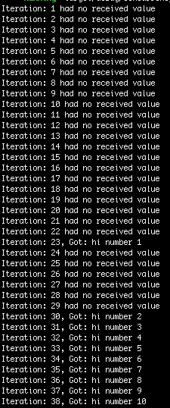

Slide 57
Here, we are going to try to access a value that we have transmitted over the channel

Slide 58
Channels help us lean on the borrow checker to ensure our code is safe!

Slide 59
Channels help us lean on the borrow checker to ensure our code is safe!
Will it compile?

Slide 60
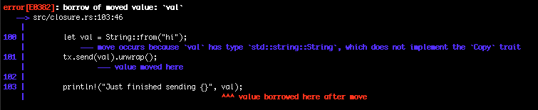
Will it compile?

Slide 62
We are going to send multiple messages from the thread

Slide 63
We are going to send multiple messages from the thread
We can watch the receiving thread get them in order
Notes:
Is for r in rx blocking?

Slide 64
Multiple producer single consumer
Ok, this mpsc stuff was supposed to be multiple producer
But we get back a tuple that has a single tx and rx end of the channel
Any ideas on how might get more than one tx?
How can we get a copy of a value on the heap?
What about if we clone() the sender somehow?
mpsc::Sender::clone(&tx)

Slide 66
We are clone()ing the tx portion of the channel we get!

Slide 67
Could also do
let tx1 = tx.clone();

Slide 68
Now, each thread we spawn can make use of a different tx channel

Slide 69
Mutexes
A mutex is a mechanism to guarantee mutual execlusion
Usually has a lock/unlock
Pretty fundamental in terms of concurrent programming
Can be used to give us safe shared memory

Slide 70
Two rules to remember
You must acquire a lock before using data it protects
When you are done with the data, you must unlock it so other threads can acquire the lock

Slide 72
We acquire the lock here

Slide 73
Note that it can throw an error, so we can unwrap() it or handle it more appropriately with other mechanisms

Slide 74
We will just sit here until we can acquire the lock (we are single threaded, so we get it right away)

Slide 75
The mutex will be guarding a reference to an i32

Slide 76
The mutex will be guarding a reference to an i32
We can dereference and modify it once we have the lock

Slide 77
Lock automatically released in its Drop implementation

Slide 79
Ok, so we can protect data
This means we can (sorta) safely share data between threads!
Let’s spin up 10 threads
Each thread will increment a counter by 1
Counter goes from 0 → 10

Slide 81
Will it compile?

Slide 82
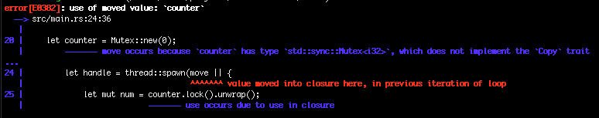
Will it compile?

Slide 83
Will it compile?
Oh. We can’t have multiple owners! Duh!

Slide 84
Reference Counting Pointers

Slide 85
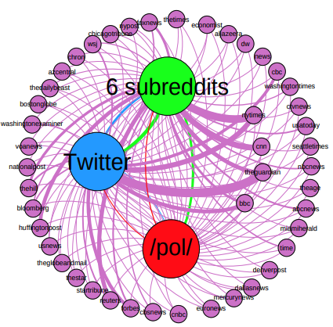
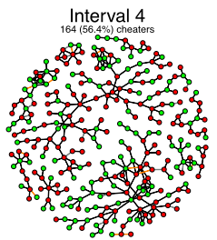
Rc<T>
How might ownership work in a graph?
Nodes are connected via edges
Edge has two owners!
What do?
Rc<T> is a reference counting smart pointer
It keeps track of the number of references pointing to a value
Zero references to a value → safe to clean up
This is different from a garbage collector!

Slide 86
Rc<T>
How is it different from a garbage collector?
How might ownership work in a graph?
Nodes are connected via edges
Edge has two owners!
What do?
Rc<T> is a reference counting smart pointer
It keeps track of the number of references pointing to a value
Zero references to a value → safe to clean up
This is different from a garbage collector!

Slide 87
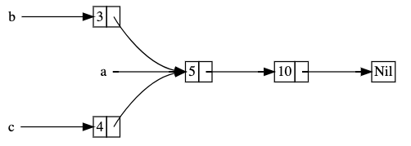
Sharing data with Rc<T>

Slide 88
Sharing data with Rc<T>
Two lists, each pointing to an item that is the head of another list

Slide 89
Sharing data with Rc<T>

Slide 90
Sharing data with Rc<T>
Will it compile?

Slide 91
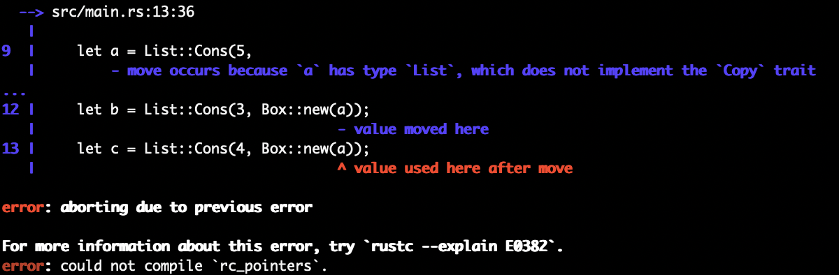
Sharing data with Rc<T>
Will it compile?

Slide 92
Sharing data with Rc<T>
The Cons type owns this Box<List>

Slide 93
Sharing data with Rc<T>
The Cons type owns this Box<List>
b owns a

Slide 94
Sharing data with Rc<T>
The Cons type owns this Box<List>
a can’t have two owners!

Slide 95
Sharing data with Rc<T>

Slide 96
Sharing data with Rc<T>
Now cons takes an Rc<List>

Slide 97
Sharing data with Rc<T>
Now cons takes an Rc<List>
Bring Rc in from the stdlib

Slide 98
Sharing data with Rc<T>
Now cons takes an Rc<List>
Note we are now declaring a to be an Rc<List>

Slide 99
Sharing data with Rc<T>
Now cons takes an Rc<List>
Everything else with a is pretty much same as Box example

Slide 100
Sharing data with Rc<T>
Now cons takes an Rc<List>
We want to have multiple ownership
a currently owns our list

Slide 101
Sharing data with Rc<T>
Now cons takes an Rc<List>
If we want b to also own it, we can clone a (which is an Rc)

Slide 102
Sharing data with Rc<T>
Now cons takes an Rc<List>
Same for c

Slide 103
Sharing data with Rc<T>
Now cons takes an Rc<List>
Note, you could do a.clone() instead of Rc::clone()
I don’t believe there is any difference between the two, and it’s mostly a style thing (but I could be wrong!)

Slide 104
Rc::clone()

Slide 105
Rc::clone()
What should this be?

Slide 106
Rc::clone()
Now we clone a.

Slide 107
Rc::clone()
Now we clone a.
What should this be?

Slide 108
Rc::clone()
New scope!

Slide 109
Rc::clone()
New scope!
clone a again
What should this be?

Slide 110
Rc::clone()
clone a again
c goes out of scope

Slide 111
Rc::clone()
clone a again
What should this be?
c goes out of scope

Slide 112
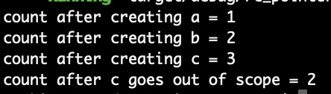
Rc::clone()

Slide 114
Let’s wrap our Mutex in an Rc

Slide 115
And now we can clone it

Slide 116
Will it compile?

Slide 117
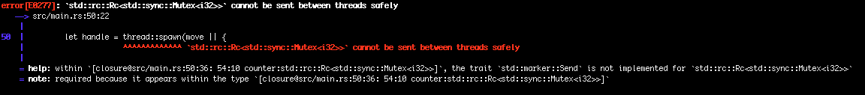

Slide 119
FUUUUUUUUUUUUUUUUUUUUUUUUUUUUUUUUUUUUUUUUUUUUUUUUUUUUUUUUUUUUUUUUUUUUUUUUUUUUUUUUUUUUUUUUUUUUUUUUUUUUUUUUUUU

Slide 120
Thread safety!
The compiler tells us
the trait `std::marker::Send` is not implemented for `std::rc::Rc<std::sync::Mutex<i32>>
Rc<T> is not thread safe
Why?
What does an Rc<T> have?
A reference count
IT’S THE SAME PROBLEM WE JUST SAW!

Slide 122
Bring in Arc

Slide 123
It’s basically a drop in replacement for Rc<T>

Slide 124
It’s basically a drop in replacement for Rc<T>

Slide 125
A word about concurrency APIs…
Rust’s built-in concurrency stuff is a bit primitive
You can of course write your own, larger abstractions around them
You could also deep and redesign everything from scratch
This would require tons of effort
https://github.com/crossbeam-rs/crossbeam
I think crossbeam mpsc is now in the std library.
https://github.com/rayon-rs/rayon
https://github.com/tokio-rs/tokio

Slide 126
Extensible Concurrency
We have basically covered all the built in concurrency features
But we will touch on asynchronous stuff still ;)
As it turns out, Rust has very few concurrency features built in
But, it does give us features that enable us to write our own features
std::marker::Sync trait
std::marker::Send trait

Slide 127
Send: Transferring Ownership Between
The Send trait indicates that ownership can be transferred between threads
Most types are Send by default
Not Rc<T>!
Why?

Slide 128
Sync: Allow access from multiple threads
The Sync trait says it’s safe for the type to be referenced from multiple threads
Any type T is Sync if &T is Send
Primitives are Sync
Rc<T> not Sync
Why?
Mutex<T> is Sync

Slide 129
Implementing Sync and Send is Unsafe
Types that are composed only of Sync/Send types are Sync/Send by default
In fact, there are no methods
They are just markers
Manually implementing the traits are not straight forward
It is inherently unsafe
We will see unsafe Rust code later…

